Slide 1

INTRODUCTION TO GIT AND GITHUB
Presented by- Groot Net Software Solutions

Slide 2
INSTALL GIT AND CREATE GITHUB ACCOUNT
Git and GitHub are not the same thing.
Git is an open-source, version control tool created in 2005 by developers working on the Linux operating system.
GitHub is a company founded in 2008 that makes tools which integrate with git.
You do not need GitHub to use git, but you cannot use GitHub without using git.
There are many other alternatives to GitHub, such as GitLab, BitBucket, and “host-your-own” solutions such as gogs and gittea. All of these are referred to in git-speak as “remotes”, and all are completely optional. You do not need to use a remote to use git, but it will make sharing your code with others easier.

Slide 3
WORLD’S FAVOURITE SOCIAL CODING PLATFORM (GIT)
What is GIT??
Git Hub is a world’s favourite social coding platform and used by millions of developers around the Globe every single day. Some of developers uses Git as their source management system. Which is off course its main goal.
Git is a free and open source distributed version control system designed to control and handle project with utmost efficiency and speed
Popular source control system
Git is a Distributed system.
Free and Open source
Why to Use Git?
Git is Fast
Since it is distributed it also work disconnected
Powerful yet easy to use
Branching
Pull Requests

Slide 4
GITHUB
GitHub is a web-based Git repository hosting service. It offers distributed revision control and Source code Management (SCM) functionality of GIT as well as adding its own features
Hosting Service based on Git
More than Just Source code Control
It offers Both Free and Paid Services
Why to Use GitHub?
Million of people using GitHub
It provides all the features of GIT and Lot more features
Social aspect of coding

Slide 5
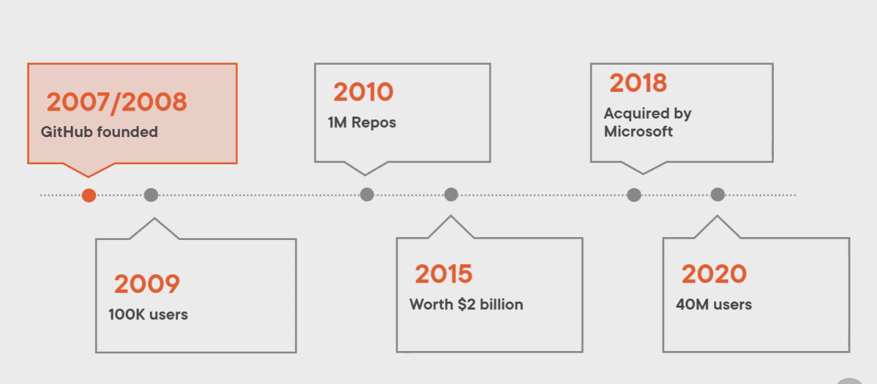
HISTORY OF GITHUB

Slide 6
HOW TO SET UP GIT AND GITHUB
Download and install the latest version of GitHub Desktop. This will automatically install Git and keep it upto-date for you.
https://help.github.com/articles/set-up-git/

Slide 7
BASIC GIT COMMANDS
Open the Git shell application.
git config - -global user.name “Arun Sharma”
git config - -global user.email arun.Sharma@grootsoftwares.com
These commands needs to be used once
For any specific project if one needs different user or different email, you can change it for that project
Cd to the project directory
Use the above commands, but leaves the -- global

Slide 8
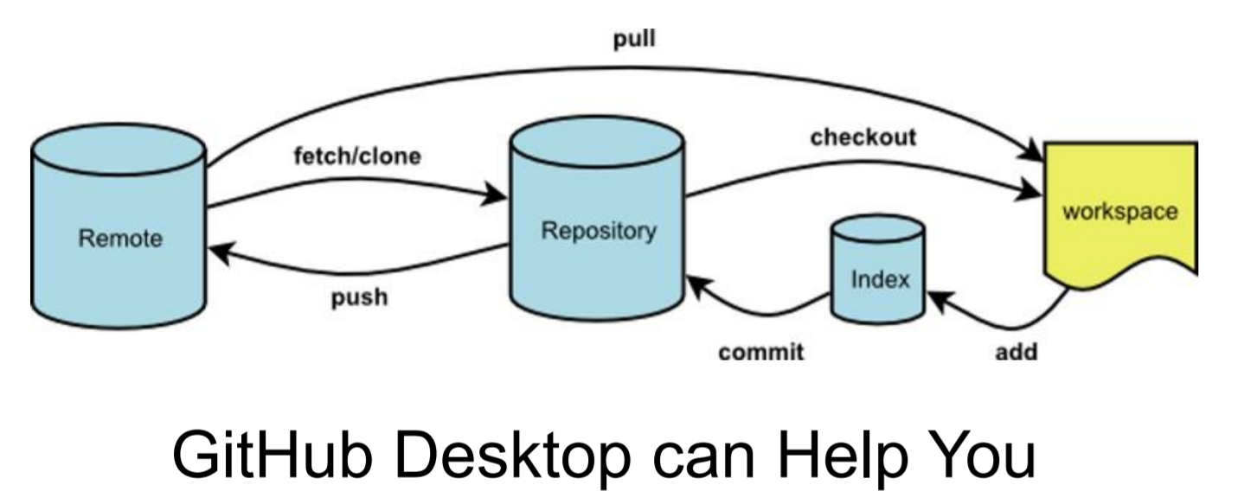
MORE COMMANDS

Slide 9
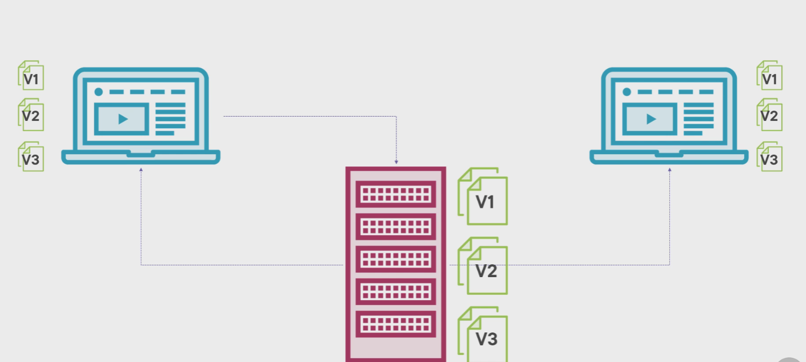
VERSION CONTROL DISTRIBUTED SYSTEM
Getting code from the Repository is Pulling and it needs to be connected. Most other operations can be done without connected.
Sending code back to Repository is Pushing

Slide 10
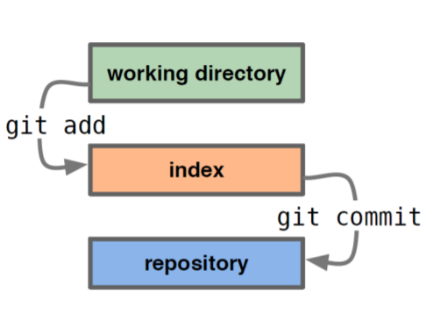
BASIC GIT COMMANDS
Typical workflow
git staus
See what Git thinks is going on
Use this frequently!
Work on your files
git add your edit files
git commit –m “What I did”

Slide 11
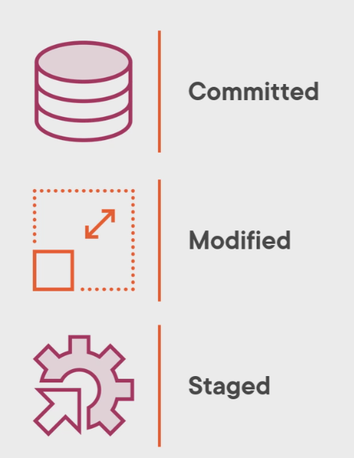
THREE STATES OF GIT
Three states are promotion based system
When content matures it can move to upper level
Committed state data stored in local database.
Modified State means that file has been changed but it has not committed to database yet
Staged State Means that modified file is marked to be part of next commit snapshot.
Most important thing is that all these stages are still in the local database

Slide 12
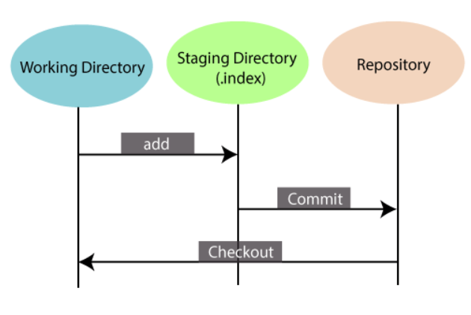
THREE AREA OF GIT
There are three areas where files can live.
Where content and files created and stays
Working Directory where the content will be created, edited and deleted.
Staging Directory can be seen as area where changes from local directory can be staged before they are committed. Only waiting to be committed
Local Git Repository (.git repo) once commit is performed the changes will be stored in the local git directory snapshot. Manged by Git itself.

Slide 13
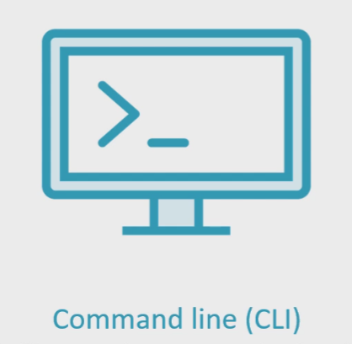

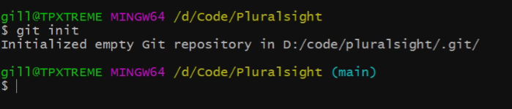
WORKING WITH GIT
There are two interface help in working with GIT
Command language Interface (CLI): - All commands starts with
$ git
$ git config //Configure the tooling
$ git init //Initialize a git local repo
$ git clone //Download a project from remote
$git Add //Prepare a file (to staging)
$git Commit //Commit a file to repository

Slide 14
CREATE A LOCAL GIT REPOSITORY
To add a file to a commit, you first need to add it to the staging environment. To do this, you can use the git add <filename> command).
Once you've used the git add command to add all the files you want to the staging environment, you can then tell git to package them into a commit using the git commit command.
Note: The staging environment, also called 'staging', is the new preferred term for this, but you can also see it referred to as the 'index'.

Slide 15
ADDING A NEW FILE TO REPO
Add a new file to the project, using any text editor you like or running a touch command. `touch newfile.txt` just creates and saves a blank file named newfile.txt.
Once you've added or modified files in a folder containing a git repo, git will notice that the file exists inside the repo. But, git won't track the file unless you explicitly tell it to. Git only saves/manages changes to files that it tracks, so we’ll need to send a command to confirm that yes, we want git to track our new file

Slide 16
ADDING A FILE IN STAGING
A commit is a record of what changes you have made since the last time you made a commit. Essentially, you make changes to your repo (for example, adding a file or modifying one) and then tell git to put those changes into a commit.
Commits make up the essence of your project and allow you to jump to the state of a project at any other commit.
So, how do you tell git which files to put into a commit? This is where the staging environment or index come in. As seen in Step 2, when you make changes to your repo, git notices that a file has changed but won't do anything with it (like adding it in a commit).
To add a file to a commit, you first need to add it to the staging environment. To do this, you can use the git add <filename> command).
Once you've used the git add command to add all the files you want to the staging environment, you can then tell git to package them into a commit using the git commit command.
Note: The staging environment, also called 'staging', is the new preferred term for this, but you can also see it referred to as the 'index'.

Slide 17
CREATE A COMMIT
Run the command given below
$git commit –m “File is committed”
The message at the end of the commit should be something related to what the commit contains - maybe it's a new feature, maybe it's a bug fix, maybe it's just fixing a typo. Any thing related to your fix.

Slide 18
CREATE A NEW BRANCH
Git Branch is very useful while dealing with different features.
Branches allow you to move back and forth between 'states' of a project.
A branch in Git is simply a lightweight movable pointer to one of these commits.’ For instance, if you want to add a new page to your website you can create a new branch just for that page without affecting the main part of the project. Once you're done with the page, you can merge your changes from your branch into the primary branch. When you create a new branch, Git keeps track of which commit your branch 'branched' off of, so it knows the history behind all the files.
By default, every git repository’s first branch is named `master` (and is typically used as the primary branch in the project).

Slide 19
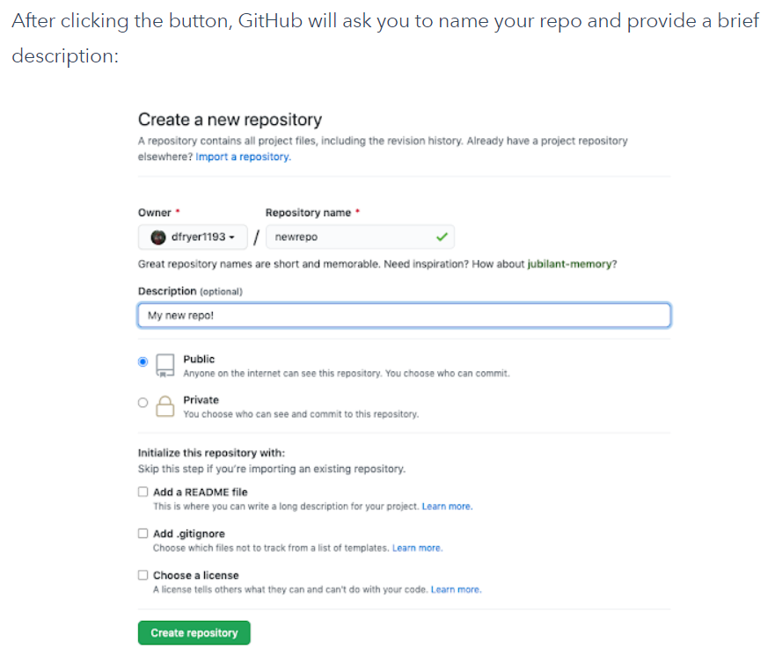
CREATE A NEW REPOSITORY ON GITHUB
If you only want to keep track of your code locally, you don't need to use GitHub. But if you want to work with a team, you can use GitHub to collaboratively modify the project's code.
To create a new repo on GitHub, log in and go to the GitHub home page. You can find the “New repository” option under the “+” sign next to your profile picture, in the top right corner of the navbar:.
By default, every git repository’s first branch is named `master` (and is typically used as the primary branch in the project).

Slide 20
PUSH A BRANCH TO GITHUB
Now we'll push the commit in your branch to your new GitHub repo. This allows other people to see the changes you've made. If they're approved by the repository's owner, the changes can then be merged into the primary branch
To push changes onto a new branch on GitHub, you'll want to run git push origin yourbranchname. GitHub will automatically create the branch for you on the remote repository:
when you clone a remote repository to your local machine, git creates an alias for you. In nearly all cases this alias is called "origin." It's essentially shorthand for the remote repository's URL. So, to push your changes to the remote repository, you could've used either the command: git push git@github.com:git/git.git yourbranchname or git push origin yourbranchname

Slide 21
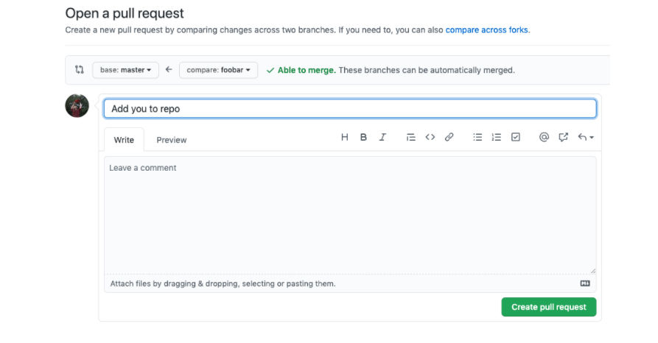
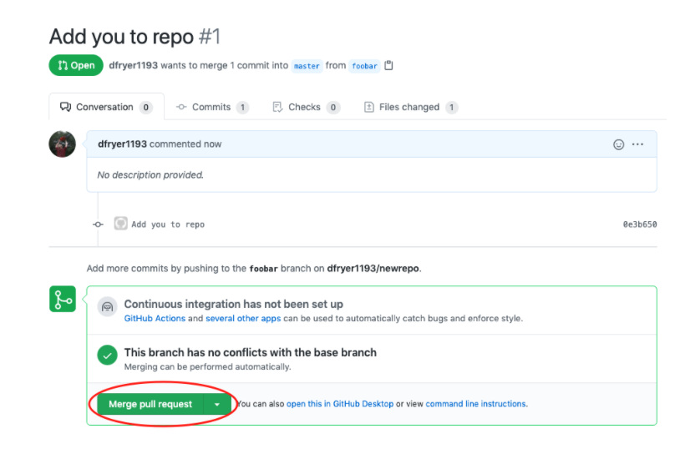
CREATE A PULL REQUEST
This is what the PR page looks like before you've submitted it.
A pull request (or PR) is a way to alert a repo's owners that you want to make some changes to their code. It allows them to review the code and make sure it looks good before putting your changes on the primary branch.
You might see a big green button at the bottom that says 'Merge pull request'. Clicking this means you'll merge your changes into the primary branch..
This what it looks like once you've submitted the PR request:

Slide 22
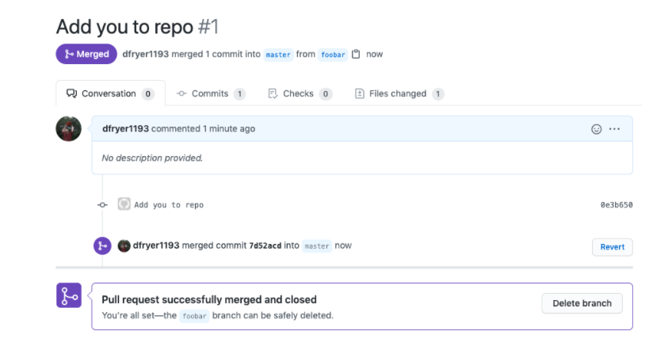
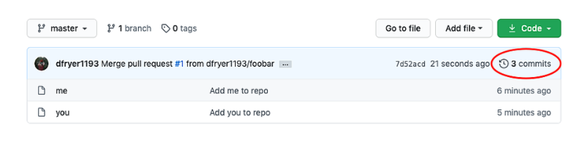
MERGE A PR
Pull Request successful Message box
.
Go ahead and click the green 'Merge pull request' button. This will merge your changes into the primary branch.
When you're done, its recommend deleting your branch (too many branches can become messy), so hit that grey 'Delete branch' button as well.
You can double check that your commits were merged by clicking on the 'Commits' link on the first page of your new repo.
This what it looks like once you've submitted the PR request:

Slide 23
GET CHANGES BACK TO YOUR PC
The repo on GitHub looks a little different than what you have on your Local PC.
The commit made in your branch and merged into the primary branch doesn't exist in the primary branch on your PC.
To get the most recent changes that you or others have merged on GitHub, use the git pull origin master command (when working on the primary branch). In most cases, this can be shortened to “$ git pull”.
Now we can use the ”$ git log” command again to see all new commits.

Slide 24

GITHUB LANDING PAGE

Slide 25
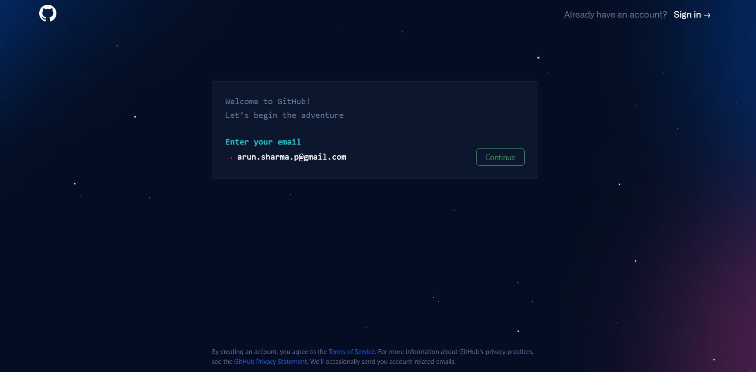
SIGNUP PAGE

Slide 26
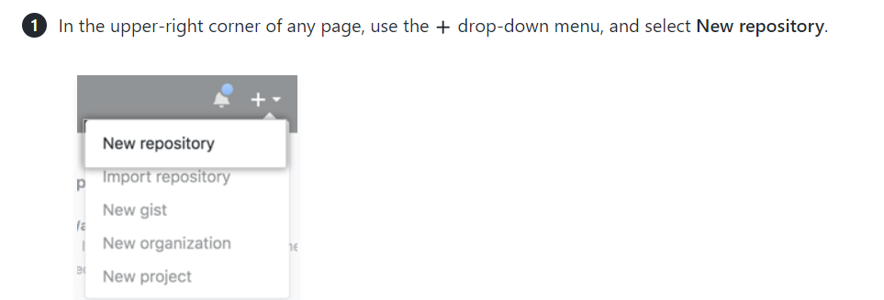
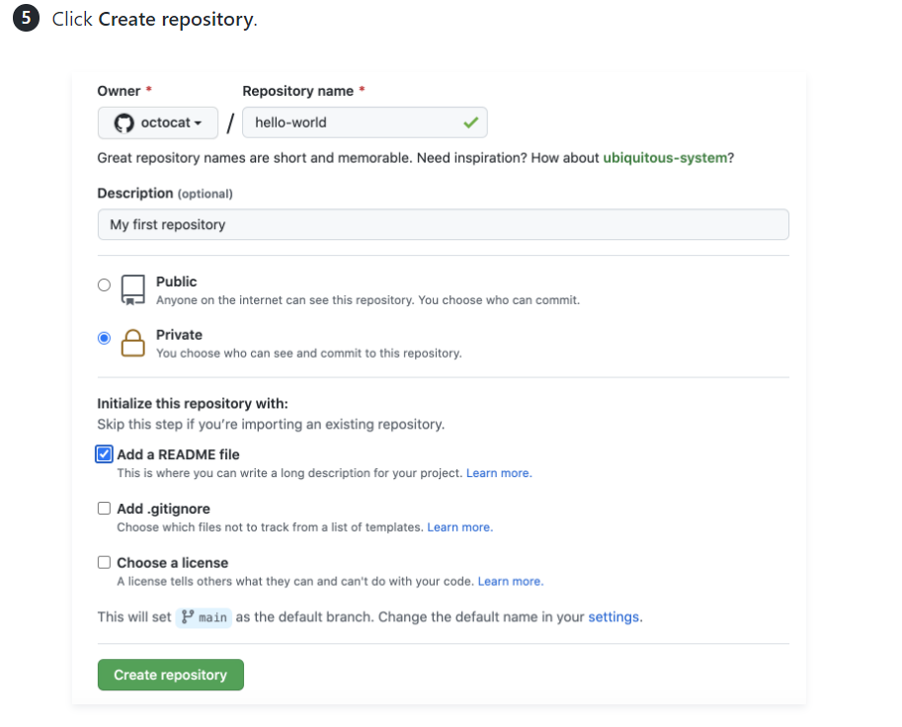
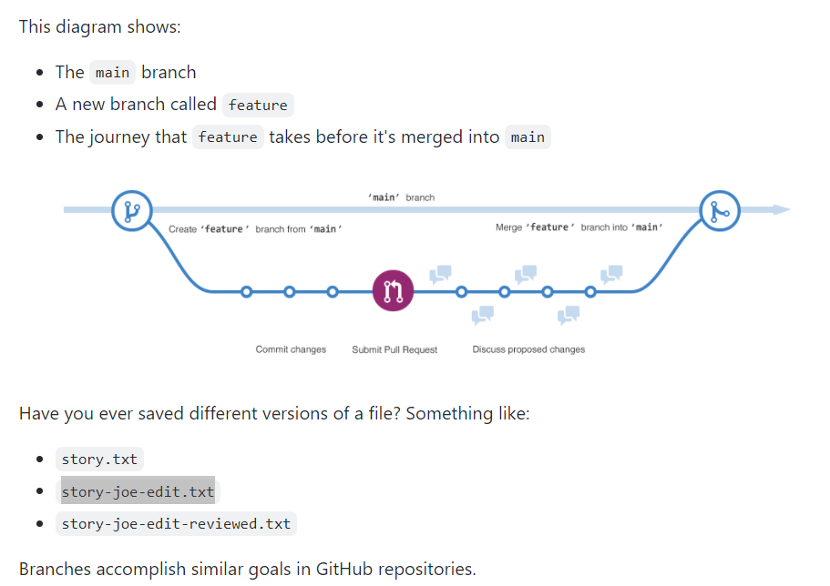
CREATING A REPOSITORY ON GITHUB

Slide 27
CREATING A BRANCH ON GIT HUB
Branching lets you have different versions of a repository at one time.By default, your repository has one branch named main that is considered to be the definitive branch. You can use branches to experiment and make edits before committing them to main. When you create a branch off the main branch, you're making a copy, or snapshot, of main as it was at that point in time.
If someone else made changes to the main branch while you were working on your branch, you could pull in those updates.
This diagram shows:
The main branch
A new branch called feature
The journey that feature takes before it's merged into main
Here at GitHub, our developers, writers, and designers use branches for keeping bug fixes and feature

Slide 28
STEPS CREATING BRANCH GIT HUB
Click the code tab of your New project repository
Click the drop down at the top of the file list that says main
Type a branch name, readme-edits into the text box
Click create branch: readme-edits from main
Now we have two branches main and readme-edits
When you created a new branch in the previous step GitHub brought you to the code page for your new readme-edits branch, which is a copy of main
You can make and save changes to the files in your repository. On GitHub, saved changes are called commits. Each commit has an associated commit message, which is a description explaining why a particular change was made commit messages capture the history of your changes so that other contributors can understand what you have done and why.
Click readme.md file
Click edit the file
In the editor, write a bit about yourself
In the Commit changes box, write a commit message that describes your changes
Click commit changes

Slide 29
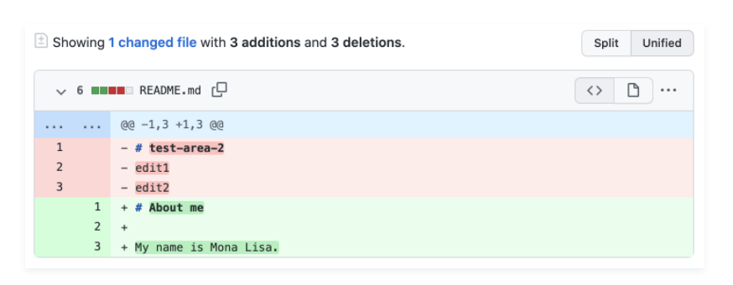
OPENING A PULL REQUEST GIT HUB
Now that you have changes in a branch off of main, you can open a pull request. Pull requests are the heart of
collaboration on GitHub. When you open a pull request, you're proposing your changes and requesting that someone
review and pull in your contribution and merge them into their branch. Pull requests show diffs, or differences, of the
content from both branches. The changes, additions, and subtractions are shown in different colors. As soon as
you make a commit, you can open a pull request and start a discussion, even before the code is finished. By using
GitHub's @mention feature in your pull request message, you can ask for feedback from specific people or teams, whether they're down the hall or 10 time zones away. You can even open pull requests in your own repository and
merge them yourself. It's a great way to learn the GitHub flow before working on larger projects. Click the Pull Requests tab of your My Project repository
Click the new Pull Request
In the Example Compression Box, Select the branch you made, readme-edits, to compare with main (Original)
Look for the changes in the diffs on the compare page, make sure they’re what you want to submit
Click Create Pull request
Give your pull request a title and write a brief description of your changes. You can include emojis and drags and drop images
Create pull Request

Slide 30
MERGING YOUR PULL REQUEST GITHUB
Finally you will merge your readme-edits branch into main branch
Click Merge pull request to merge the changes into main.
Click Confirm merge
Go ahead and delete the branch, since its changes have been incorporated, by Delete branch

